Slide 1

Lecture 3: IT in communication
Hoger Mahmud

Slide 2



Lecture outline
The concept of communication
Networks
Software and hardware used in communication
Advantages of communication
2

Slide 3



Concept of communication Technology
Communication : is the exchange of data and information between two or more participants.
Communication types
Verbal
None -Verbal
Written
3

Slide 4
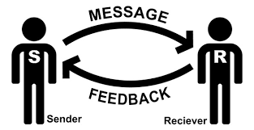
Principle of communication
Sender: anyone or anything sending a message
Receiver: anything or anyone receiving the message
Message: the data or information being exchanged
Feedback: the reply to the message
4

Slide 5
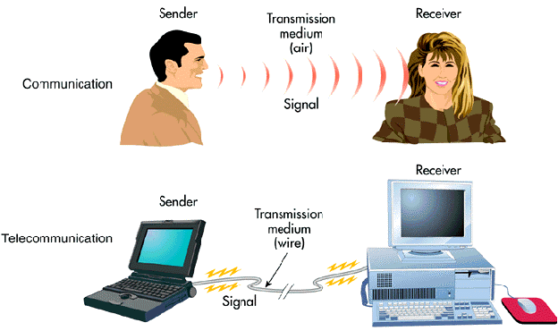
Transmission medium
m
5

Slide 6
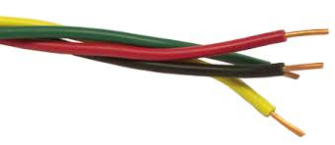
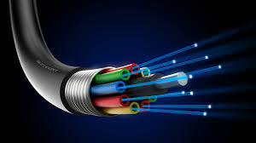
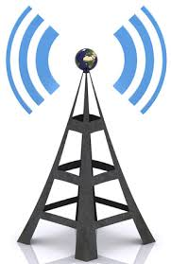
Medium types
Wired communication
Insulated pairs of wires mainly made of copper
Fiber-optic
Many extremely thin strands of glass or plastic bound together which transmits signals with light beams
Wireless
Information is converted to microwave signals,
sent through the air to a receiver
6

Slide 7

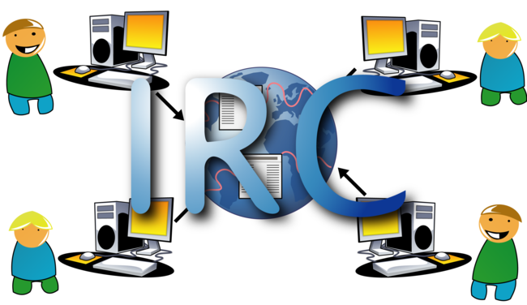
Methods of Communication
Internet
Web (documents)
E-mail
Instant Messaging
Chat Rooms
Newsgroups
FTP
Video Conferencing
Social Networks
7

Slide 8
Computer network
Computer network…
The communications media, devices, and software needed to connect two or more computer systems and/or devices
Used to share hardware, programs, and databases across an organization
Fosters teamwork, innovative ideas, and new business strategies
8

Slide 9
Networks
Communication takes place within networks.
Some of the types of networks:
chain
circle
wheel
all-channel
WAN
Wide Area Network
LAN
Local Area Network
9

Slide 10
Chain network
A chain network e.g formal contact
10

Slide 11
Circle network
A circle network e.g. between people at the same level
11

Slide 12
All channel network
All channel network e.g. The internet
12

Slide 13
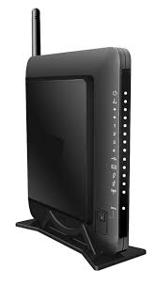
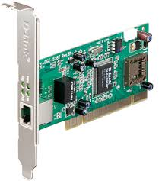
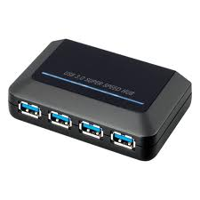
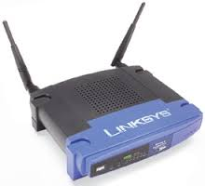
Communication hardware
Modem – device used to convert between analog and digital signals
NIC - computer hardware to allow the attached computer to communicate by network
Hub -a device for connecting multiple twisted pair of wires or fiber-optic
Repeater -retimes and regenerates the signals to proper amplitudes and sends them to the other devices
13

Slide 14
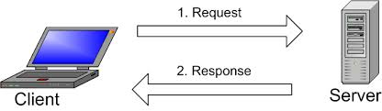
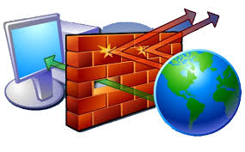
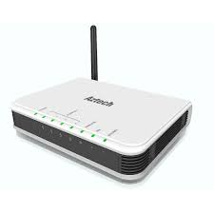
Communication hardware 2
Client/Server –one or more computers serve the requests of other computers
Firewall -a piece of hardware or software put on the network to prevent some communications forbidden by the network policy
Router -router is used to route data packets between two networks
14

Slide 15
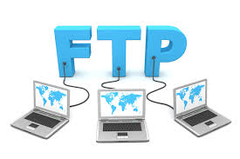


Software used in communication
Communication Software: is an application or program designed to pass information from one system to another.
Examples:
FTP (File Transfer Protocol)
VoIP (Voice over Internet Protocol)
(VC)Video Chat
Email
15

Slide 16
Benefits of Communication Technology
Better Communication: One of the greatest features of networks is electronic mail.
Sharing of Programs and Data: In most organizations, people use the same software and need access to the same data
Sharing of Peripheral devices : such as laser printers, disk drives, and scanners
Access to Database : Networks enable users to tap into numerous databases. Private or public databases are available online through the internet or intranet.
Security of Information: Before networks became common, an individual employee might have been the only one with a particular piece of information, which was stored in his or her desktop computer
16

Slide 17
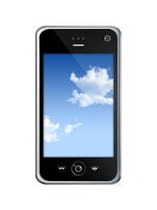



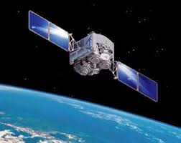
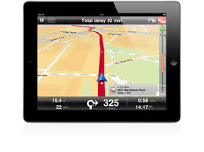

Examples of IT in communication
j
17

Slide 18

Thank you
?

